Slide 1

Intro
What achievements do you fantasize about?
Success is directly linked to connections.
People can lift you up to your goals.

Slide 2
Preview
To pull people into your reality
Move past misconceptions
Type yourself
Stay positive
Be patient

Slide 3
Misconceptions
I. Personality Typing
A. Myers Briggs
B. Boxes
Stereotypes
A. Introvert
B. Extrovert

Slide 4
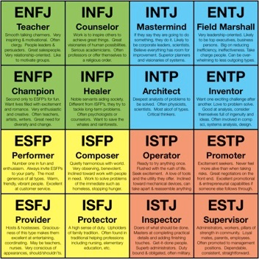
Type Yourself
Know who you are
Use this to relate to others
Continue to grow

Slide 5
Positive Energy
Attraction plays a huge role
This includes energy levels
Also being accepting of others

Slide 6
Patience
Typing can help you find challenges
You will encounter the biggest growths

Slide 7
Conclusion: Summary
To attract the right people
Move past misconceptions
Type yourself
Stay positive
Be patient

Slide 8
Conclusion: Concluding Remark
You need to build a solid social foundation to achieve greatness.

Slide 9
References
[1] “Myers Briggs : A Misunderstood Test that Gives Valuable Information” Internet: https://www.pinterest.com/pin/260575528417018301, 2017 [9/20/2017].
[2] Internet: https://www.advancedphotoshop.co.uk/image/49917/resurrection_of_gaia__desktopography_2012, 2017 [9/20/2017].

Slide 10
Contact Information
Alex Lundin
Junior
Software Engineering
AML140830@utdallas.edu

